Slide 1

Analysing and Interpreting Financial Statements
Bemm115DA
Financial Ratios
Martin Pike

Slide 2

Learning Outcomes
At the end of this session, you should be able to:
Identify the major categories of ratios that can be used for analysing financial statements
Calculate key ratios for assessing the financial performance and position of a business
Explain the significance of the ratios calculated
Discuss the limitations of ratios as a tool of financial analysis

Slide 3
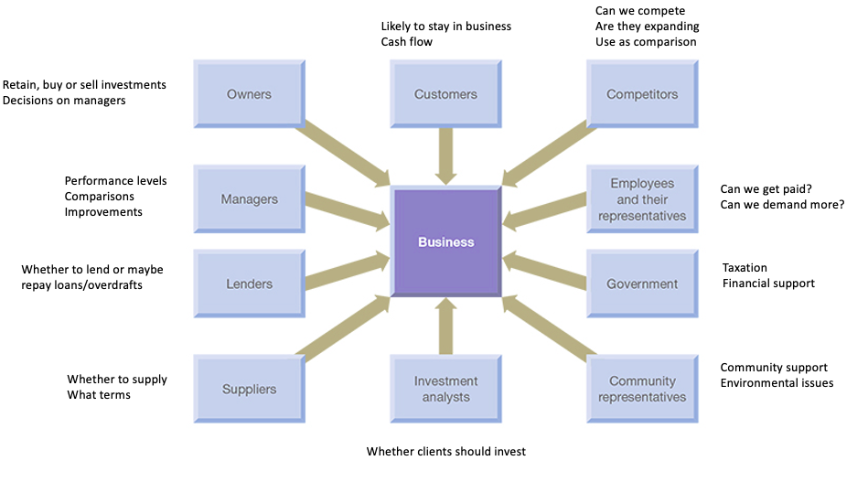
Previously, we identified stakeholders.
These parties may be interested in the interpretation of financial statements.

Slide 4
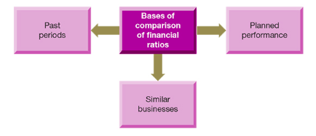
Need for Comparison

Slide 5
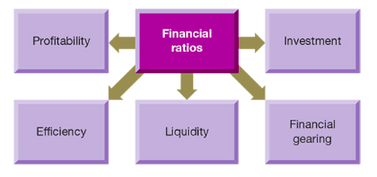
Ratio Classification

Slide 6
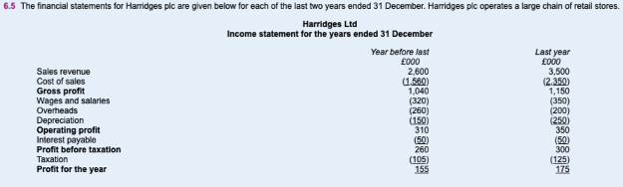
Atrill and McLaney Exercise 6.5

Slide 7
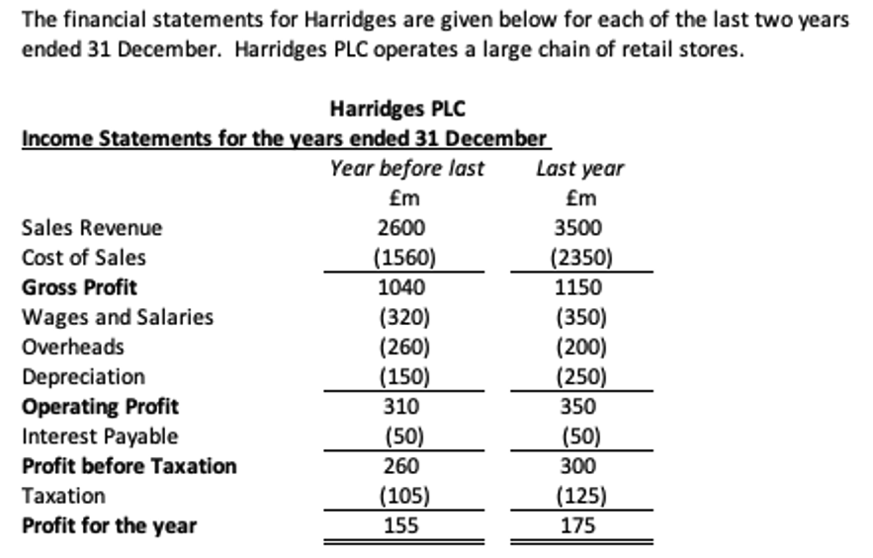

Slide 8
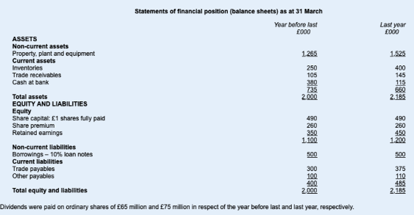

Slide 9
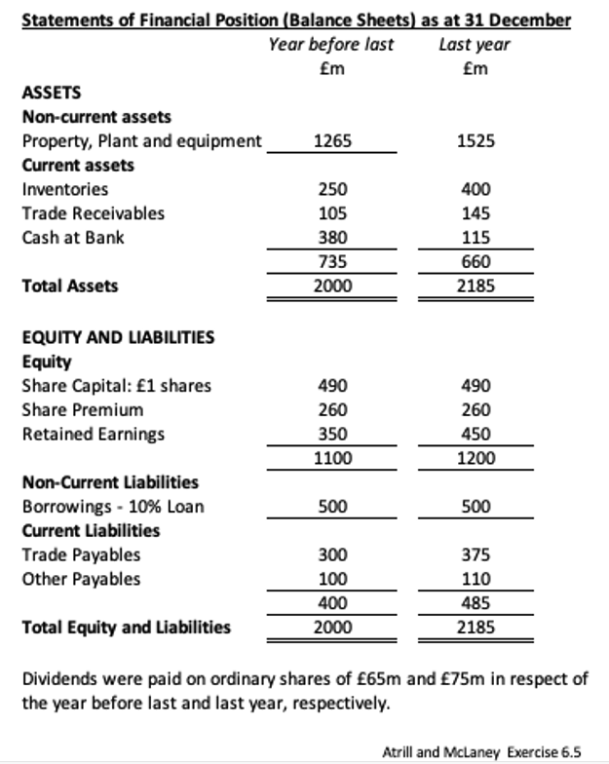

Slide 10

Profitability Ratios
Gross profit margin
Operating profit margin
Return on capital employed (ROCE)
Return on ordinary shareholders funds

Slide 11
Gross profit margin
Gross profit margin = Gross profit x 100
Sales revenue
Gross profit margin = 1040 x 100 = 40%
2600
(for each £1 of sales revenue 40p was left to cover other operating expenses)
Year before last
Calculate the Gross Profit Margin for Last Year
32.9%

Slide 12
Operating profit margin
Operating profit margin = Operating profit x 100
Sales Revenue
( Before interest payable – difference in financing does not influence)
Operating profit margin = 310 x 100 = 11.9%
2600
Year before last
Calculate the Operating Profit Margin for Last Year
10%

Slide 13
Return on capital employed (ROCE)
ROCE = Operating profit x 100
Share capital + Reserves + Non-current liabilities
(Profit before interest and tax is used)
ROCE = 310 x 100 = 19.4%
1100 + 500
Year before last
Calculate the ROCE for Last Year
20.6%

Slide 14
Return on ordinary shareholders funds (ROSF)
ROSF = Profit for the year x 100
Ordinary share capital + Reserves
ROSF = 155 x 100 = 14.1%
1100
Year before last
Calculate the ROSF for Last Year
14.6%

Slide 15

Observations
Operating profit margin down 2%, gross profit margin down 7% - Overheads controlled during last year. Not risen in proportion to sales
Slight in ROSF and ROCE. Small increase in sales revenue
What were the planned levels?
increase in sales and decline in gross profit margin suggests price cutting policy.
Individual expenses in comparison to sales revenue could be calculated

Slide 16

Efficiency Ratios
Inventories turnover period
Settlement period for trade receivables
Settlement period for trade payables
Sales revenue to capital employed (Net asset turnover ratio)
Sales revenue per employee (Data not available here)

Slide 17
Inventories Turnover Period
Inventories turnover period = Inventories x 365
Cost of sales
Inventories turnover period = 250 x 365 = 58 Days
1560
Year before last
Calculate the Inventory turnover period for Last Year
62 Days

Slide 18
Settlement period for trade receivables
Settlement period for trade receivables =
Trade receivables x 365
Credit sales revenue
Settlement period for trade receivables = 105 x 365 = 15 Days
2600
Year before last
Calculate the Settlement period for trade receivables for Last Year
15 Days

Slide 19
Settlement period for trade payables
Settlement period for trade payables =
Trade payables x 365
Credit purchases
Settlement period for trade payables = 300 x 365 = 70 Days
1560
Year before last
Calculate the Settlement period for trade payables for Last Year
58 Days

Slide 20
Sales revenue per employee
Sales revenue per employee = Sales revenue
Number of employees

Slide 21
Efficiency/Activity ratios summarised
 | Year before last | Last year
Average inventories turnover | 58 days | 62 days
Settlement period for trade receivables | 15 days | 15 days
Settlement period for trade payables | 70 days | 58 days
Sales revenue per employee | N/A | N/A
Inventories turnover period maintained
Trade receivables settlement period maintained/shorter trade payables settlement period – careful
about goodwill
All results need to be compared with planned targets set

Slide 22

Liquidity ratios
Current ratio
Acid test ratio
Gearing ratio
Interest cover ratio

Slide 23
Current ratio
Current ratio = Current assets
Current liabilities
Current ratio = 735 = 1.8 or (1.8:1)
400
Year before last
Calculate the Current Ratio for Last Year
1.4 or (1.4:1)

Slide 24
Acid test ratio
Acid test ratio = Current assets less inventories
Current liabilities
Acid test ratio = 735 - 250 = 1.2 or (1.2:1)
400
Year before last
Calculate the Acid Test Ratio for Last Year
0.5 or (0.5:1)

Slide 25
Thoughts on the two ratios
 | Year before last | Last year
Current ratio | 1.8 | 1.4
Acid test ratio | 1.2 | 0.5
Last year ratios significantly less – cause for concern – investigated and corrective action taken
Could be planned in short-term – linked to increase in non-current assets and employees
Lenders and suppliers may become anxious – press for payment – cause further problems

Slide 26
Gearing ratio
The gearing ratio measures the contribution of long-term lenders to the long-term
Capital structure of a business
Gearing ratio = Long-term(Non-current) Liabilities X 100
Share capital + Reserves + Long-term(Non-current) Liabilities
Year before last
Gearing ratio = 500 x 100 = 31.3%
1100+500
Calculate the Gearing Ratio for Last Year
29.4%
Reasonably low gearing
No cause for concern

Slide 27
Interest cover ratio
This measures the amount of operating profit available to cover interest payable
Interest cover ratio = Operating profit
Interest payable
Interest cover ratio = 310 = 6.2 times
50
Year before last
Calculate the Interest cover for Last Year
7 times

Slide 28

Further ratios
Dividend payout ratio
Dividend yield ratio
Earnings per share
Price/earnings ratio

Slide 29
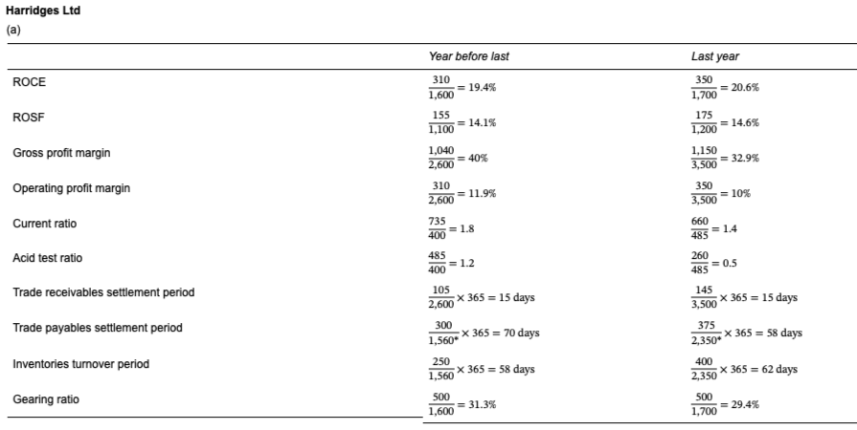

Slide 30
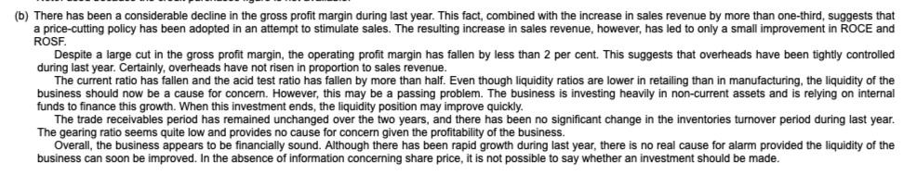

Slide 31
Limitations of Ratio Analysis
Quality of financial statements
Inflation
Over-reliance on ratios
Basis for comparison
Statement of Financial Position ratios – snapshot in time

Slide 32
Lord Weinstock (1924 -2002) wrote:-
The operating ratios are of great value as measures of efficiency, but they are only the measures and not efficiency itself. Statistics will not design a product better, make it for a lower cost or increase sales. If ill-used, they may so guide action as to diminish resources for the sake of apparent but false signs of improvement.
Management remains a matter of judgement, of knowledge of products and processes and of understanding and skill in dealing with people. The ratios will indicate how well all these things are being done and will show comparison with how they are done elsewhere. But they will tell us nothing about how to do them. That is what you are meant to do.

Slide 33
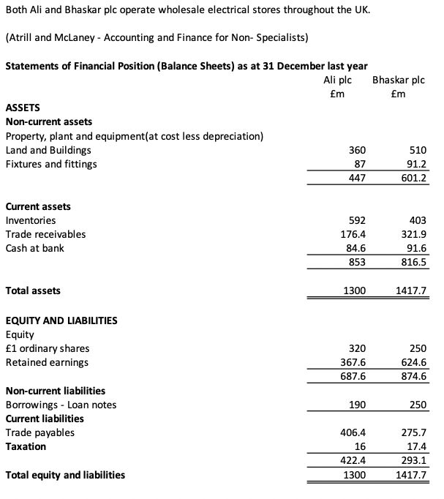
Handout 5

Slide 34
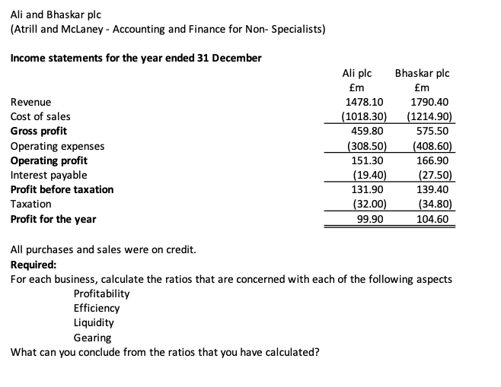
Handout 5

